Slide 1
Object Localization. Object Detection. Faster R-CNN.
Radu Ionescu Bogdan Alexe
raducu.ionescu@gmail.com bogdan.alexe@fmi.unibuc.ro
Faculty of Mathematics and Computer Science
University of Bucharest

Slide 2
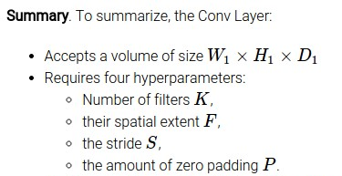
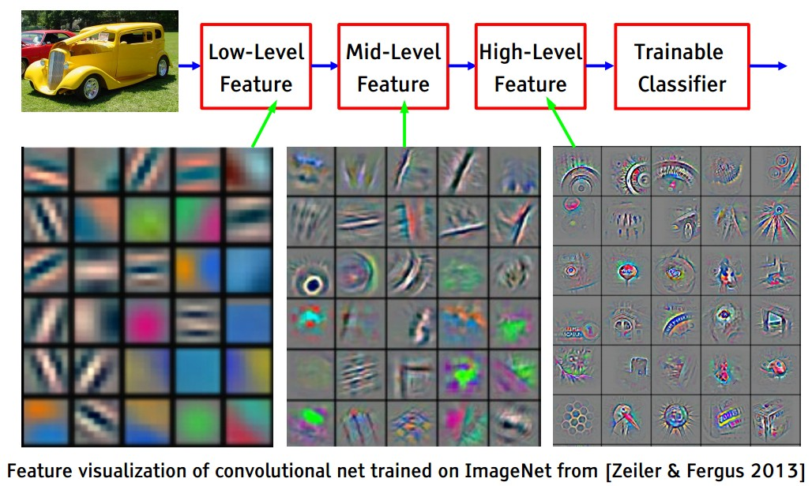
Convolution
32
32
3

Slide 3
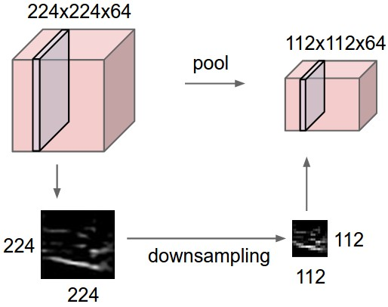
Pooling
1 | 1 | 2 | 4
5 | 6 | 7 | 8
3 | 2 | 1 | 0
1 | 2 | 3 | 4
2x2 max pooling
6 | 8
3 | 4

Slide 4
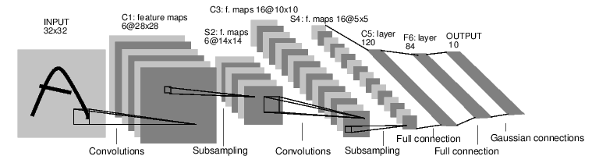
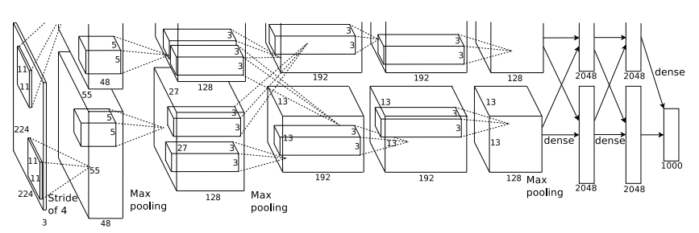
Case Studies
LeNet (1998)
AlexNet (2012)

Slide 5
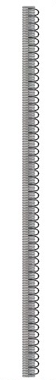
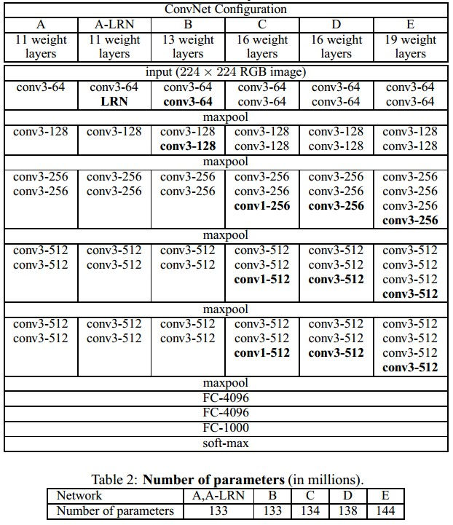
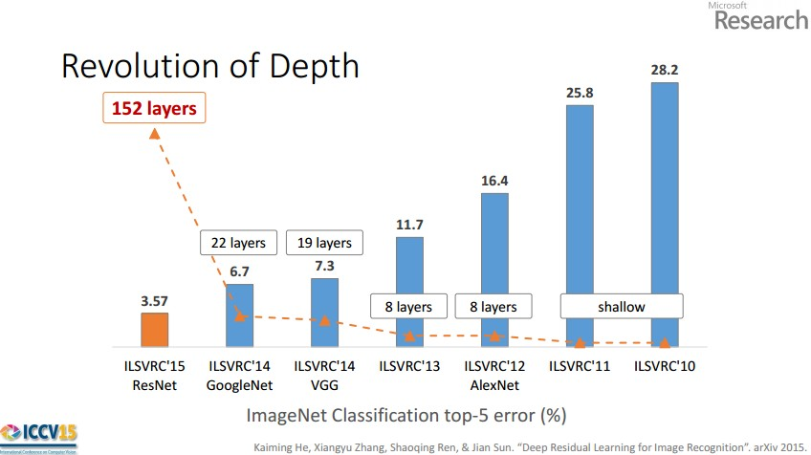
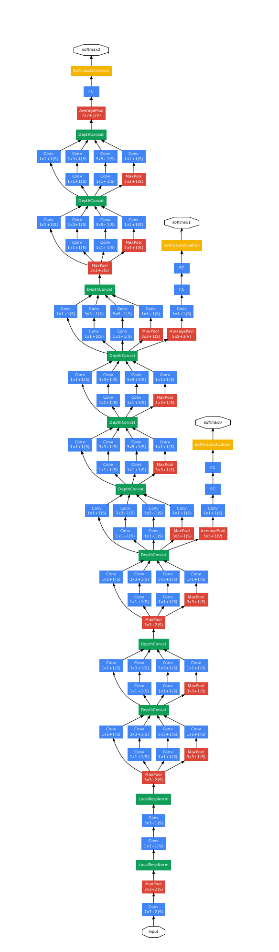
Case Studies
VGG (2014)
GoogLeNet (2014)
ResNet (2015)

Slide 6
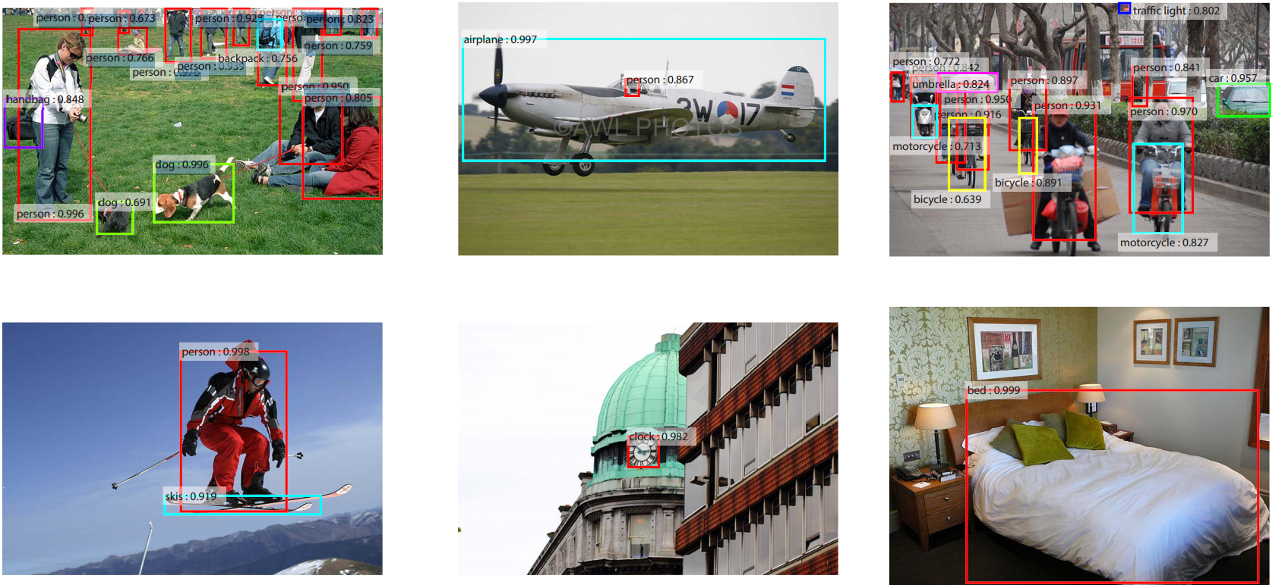
Localization and Detection
Results from Faster R-CNN, Ren et al 2015

Slide 7
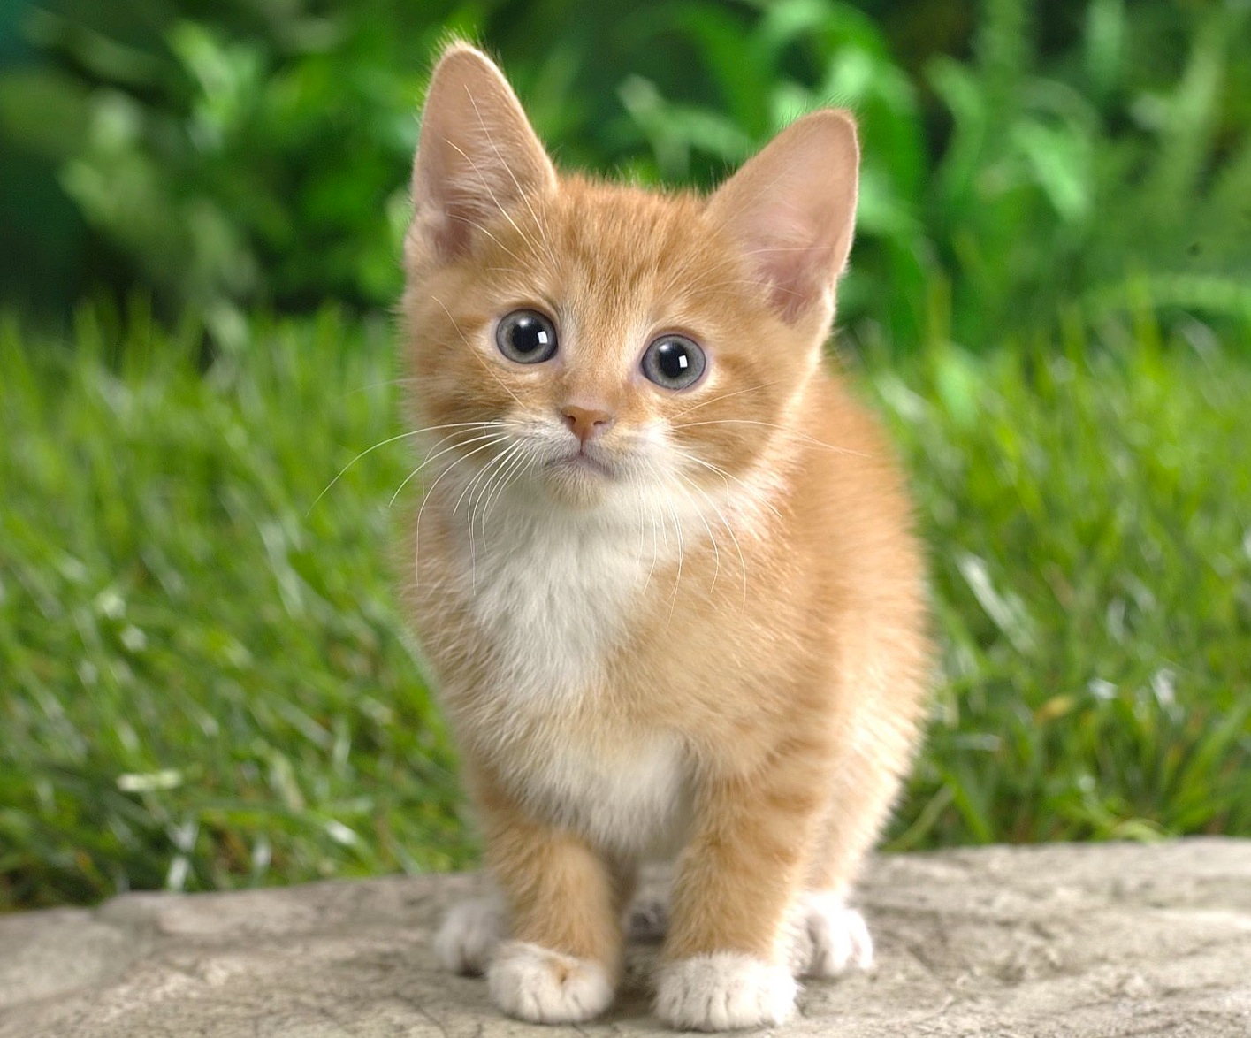
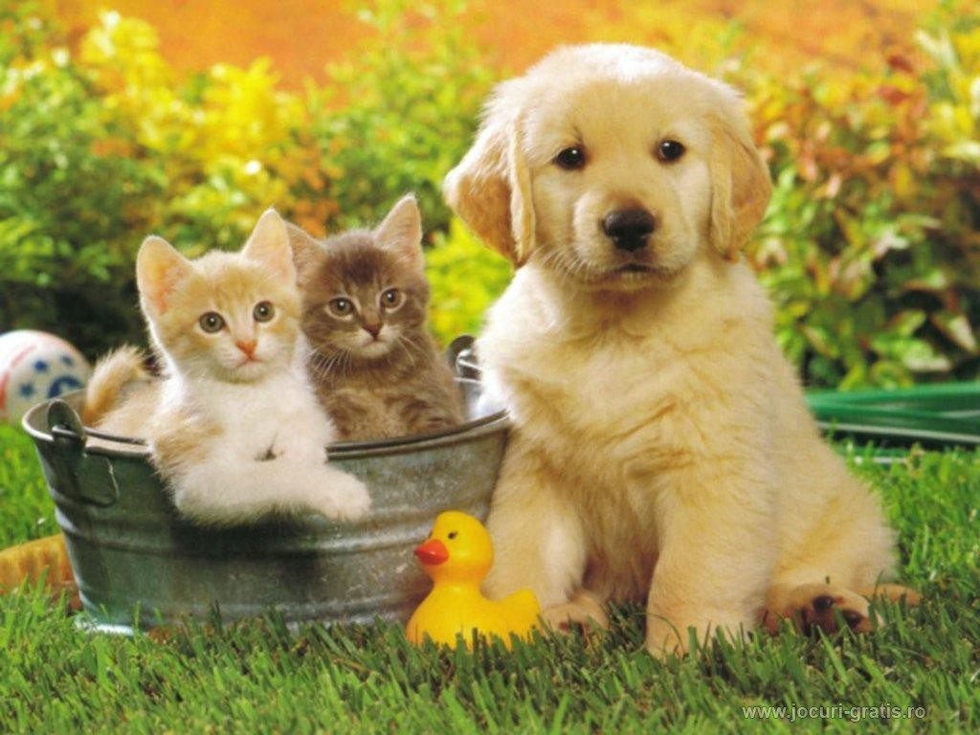
Computer Vision Tasks
Classification
Classification + Localization
Object Detection
Instance Segmentation
CAT
CAT
CAT, DOG, DUCK
CAT, DOG, DUCK
Single object
Multiple objects

Slide 8
Computer Vision Tasks
Classification
Classification + Localization
Object Detection
Instance Segmentation

Slide 9
Classification + Localization: Task
Classification: C classes
Input: Image
Output: Class label
Evaluation metric: Accuracy
Localization:
Input: Image
Output: Box in the image (x, y, w, h)
Evaluation metric: Intersection over Union
Classification + Localization: Do both
CAT
(x, y, w, h)

Slide 10
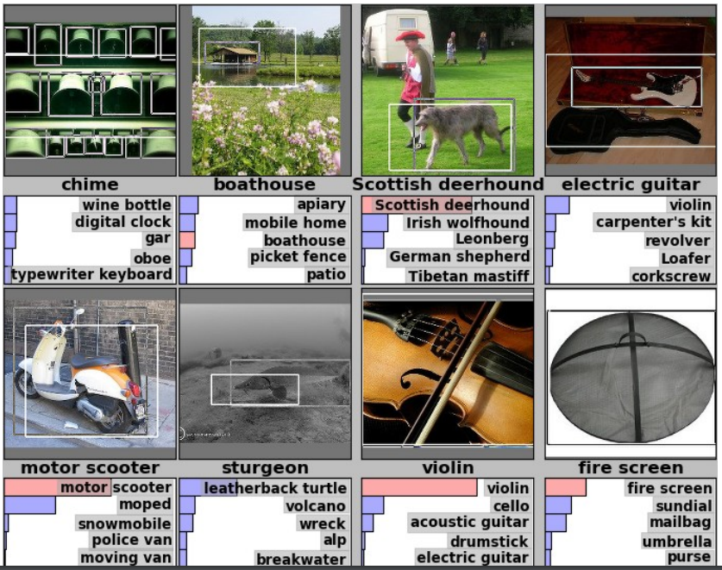
Classification + Localization: ImageNet
1000 classes (same as classification)
Each image has 1 class, at least one bounding box
~800 training images per class
Algorithm produces 5 (class, box) guesses
Example is correct if at least one one guess has correct class AND bounding box at least 0.5 intersection over union (IoU)
Krizhevsky et. al. 2012

Slide 11
Idea #1: Localization as Regression
Input: image
Neural Net
Output: Box coordinates
(4 numbers)
Loss:
L2 distance
Correct output: Box coordinates
(4 numbers)
Only one object, simpler than detection

Slide 12
Simple Recipe for Classification + Localization
Step 1: Train (or download) a classification model (AlexNet, VGG, GoogLeNet)
Convolution
and Pooling
Fully-connected layers
Softmax loss
Final conv feature map
Class scores
Image

Slide 13
Simple Recipe for Classification + Localization
Step 2: Attach new fully-connected “regression head” to the network
Fully-connected layers
“Classification head”
Convolution
and Pooling
Class scores
Fully-connected layers
“Regression head”
Final conv feature map
Image
Box coordinates

Slide 14
Simple Recipe for Classification + Localization
Step 3: Train the regression head only with SGD and L2 loss
Fully-connected layers
Convolution
and Pooling
Class scores
Fully-connected layers
L2 loss
Final conv feature map
Image
Box coordinates

Slide 15
Simple Recipe for Classification + Localization
Step 4: At test time use both heads
Fully-connected layers
Convolution
and Pooling
Class scores
Fully-connected layers
Final conv feature map
Image
Box coordinates

Slide 16
Per-class vs class agnostic regression
Assume classification over C classes:
Fully-connected layers
Classification head:
C numbers (one per class)
Convolution
and Pooling
Class scores
Class agnostic: 4 numbers
(one box)
Fully-connected layers
Class specific: C x 4 numbers
(one box per class)
Final conv feature map
Image
Box coordinates

Slide 17
Where to attach the regression head?
After conv layers:
Overfeat, VGG
After last FC layer:
DeepPose, R-CNN
Convolution
and Pooling
Fully-connected layers
Softmax loss
Final conv feature map
Class scores
Image

Slide 18
Aside: Localizing multiple objects
Want to localize exactly K objects in each image
(e.g. whole cat, cat head, cat left ear, cat right ear for K=4)
Fully-connected layers
Convolution
and Pooling
Class scores
Fully-connected layers
K x 4 numbers
(one box per object)
Final conv feature map
Image
Box coordinates

Slide 19
Idea #2: Sliding Window
Run classification + regression network at multiple locations on a high-resolution image
Convert fully-connected layers into convolutional layers for efficient computation
Combine classifier and regressor predictions across all scales for final prediction

Slide 20
Sliding Window: Overfeat
Class scores:
1000
4096
4096
Winner of ILSVRC 2013
localization challenge
FC
FC
Convolution + pooling
Softmax loss
FC
FC
Feature map: 1024 x 5 x 5
FC
FC
Image: 3 x 221 x 221
Euclidean
loss
1024
Boxes: 1000 x 4
Sermanet et al, “Integrated Recognition, Localization and Detection using Convolutional Networks”, ICLR 2014
4096

Slide 21
Sliding Window: Overfeat
Network input: 3 x 221 x 221
Larger image: 3 x 257 x 257

Slide 22
Sliding Window: Overfeat
0.5
Network input: 3 x 221 x 221
Larger image: 3 x 257 x 257
Classification scores: P(cat)

Slide 23
Sliding Window: Overfeat
0.5 | 0.75
Network input: 3 x 221 x 221
Larger image: 3 x 257 x 257
Classification scores: P(cat)

Slide 24
Sliding Window: Overfeat
0.5 | 0.75
0.6
Network input: 3 x 221 x 221
Larger image: 3 x 257 x 257
Classification scores: P(cat)

Slide 25
Sliding Window: Overfeat
0.5 | 0.75
0.6 | 0.8
Network input: 3 x 221 x 221
Larger image: 3 x 257 x 257
Classification scores: P(cat)

Slide 26
Sliding Window: Overfeat
0.5 | 0.75
0.6 | 0.8
Network input: 3 x 221 x 221
Larger image: 3 x 257 x 257
Classification scores: P(cat)

Slide 27
Sliding Window: Overfeat
Greedily merge boxes and scores (details in paper)
0.8
Network input: 3 x 221 x 221
Larger image: 3 x 257 x 257
Classification score: P(cat)

Slide 28
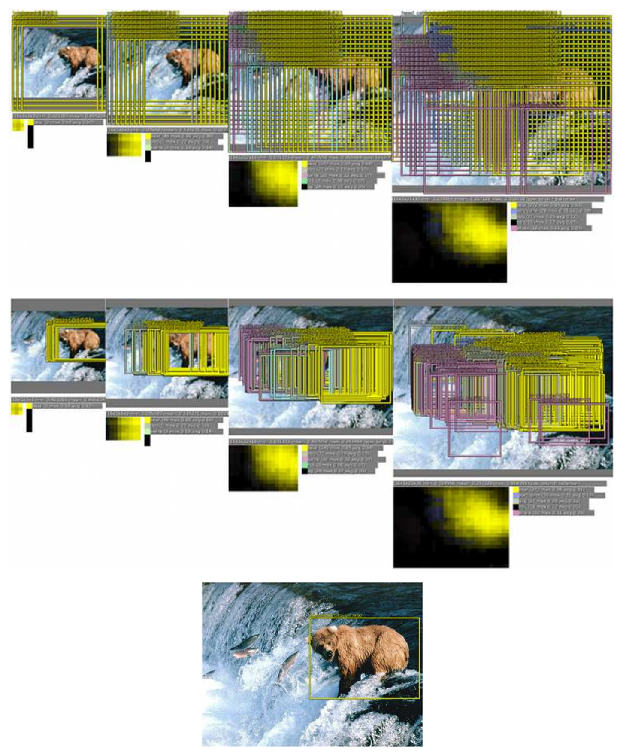
Sliding Window: Overfeat
In practice use many sliding window locations and multiple scales
Window positions + score maps
Box regression outputs
Final Predictions
Sermanet et al, “Integrated Recognition, Localization and Detection using Convolutional Networks”, ICLR 2014

Slide 29
Efficient Sliding Window: Overfeat
4096
4096
Class scores:
1000
FC
FC
Convolution + pooling
FC
FC
Feature map: 1024 x 5 x 5
FC
FC
Image: 3 x 221 x 221
1024
Boxes: 1000 x 4
4096

Slide 30
Efficient Sliding Window: Overfeat
Efficient sliding window by converting fully-connected layers into convolutions
Class scores: 1000 x 1 x 1
4096 x 1 x 1
1024 x 1 x 1
Convolution + pooling
1 x 1 conv
1 x 1 conv
5 x 5 conv
5 x 5 conv
Feature map: 1024 x 5 x 5
1 x 1 conv
1 x 1 conv
Image: 3 x 221 x 221
4096 x 1 x 1
1024 x 1 x 1
Box coordinates: (4 x 1000) x 1 x 1

Slide 31
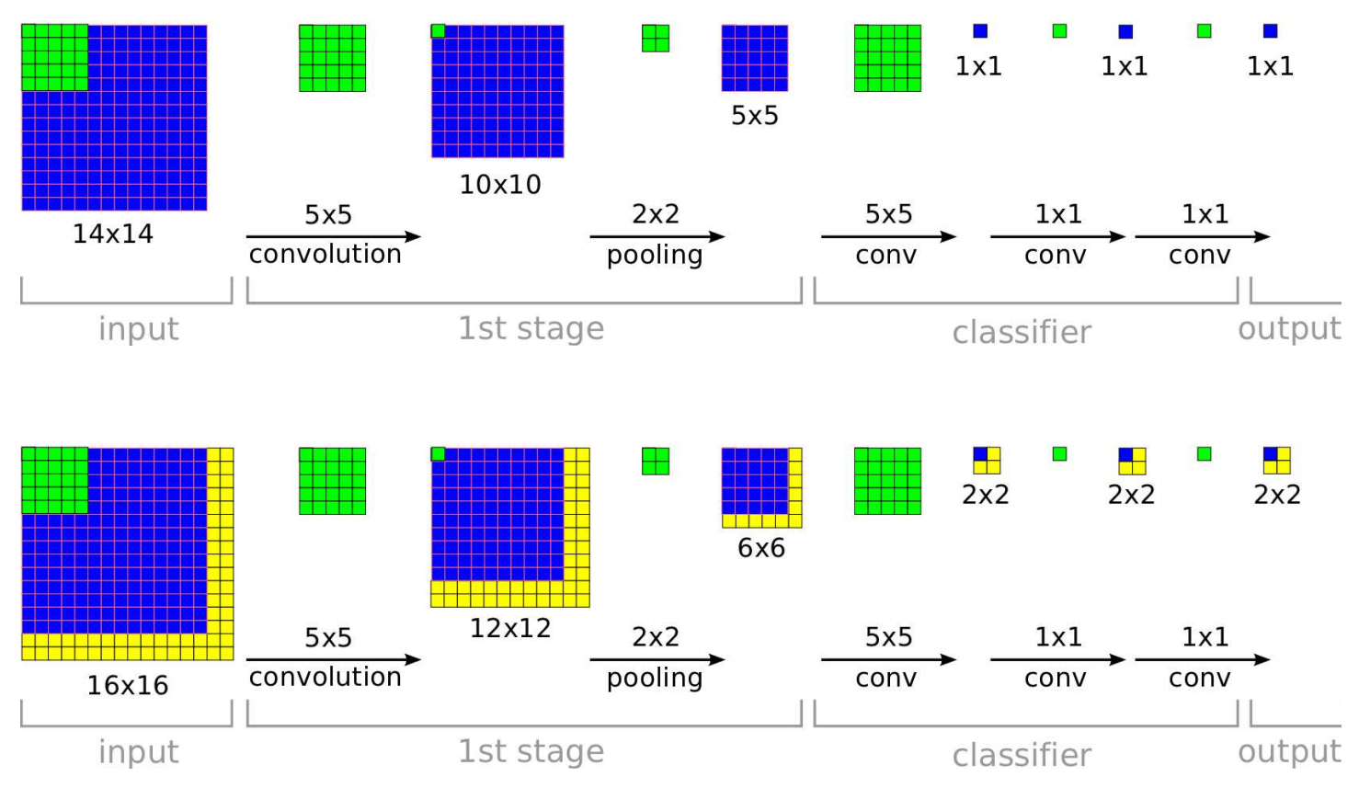
Efficient Sliding Window: Overfeat
Training time: Small image, 1 x 1 classifier output
Test time: Larger image, 2 x 2 classifier output, only extra compute at yellow regions
Sermanet et al, “Integrated Recognition, Localization and Detection using Convolutional Networks”, ICLR 2014

Slide 32
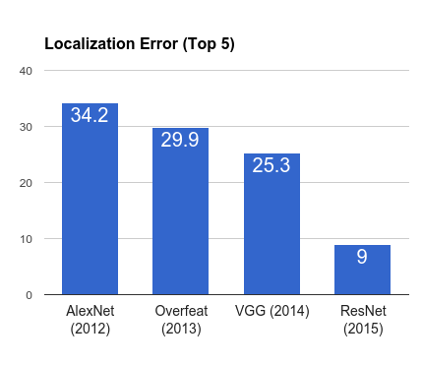
ImageNet Classification + Localization
AlexNet: Localization method not published
Overfeat: Multiscale convolutional regression with box merging
VGG: Same as Overfeat, but fewer scales and locations; simpler method, gains all due to deeper features
ResNet: Different localization method (RPN) and much deeper features

Slide 33
Computer Vision Tasks
Classification
Classification + Localization
Object Detection
Instance Segmentation

Slide 34
Computer Vision Tasks
Classification
Classification + Localization
Object Detection
Instance Segmentation

Slide 35
Detection as Regression?
DOG, (x, y, w, h)
CAT, (x, y, w, h)
CAT, (x, y, w, h)
DUCK (x, y, w, h)
= 16 numbers

Slide 36

Detection as Regression?
DOG, (x, y, w, h)
CAT, (x, y, w, h)
= 8 numbers

Slide 37
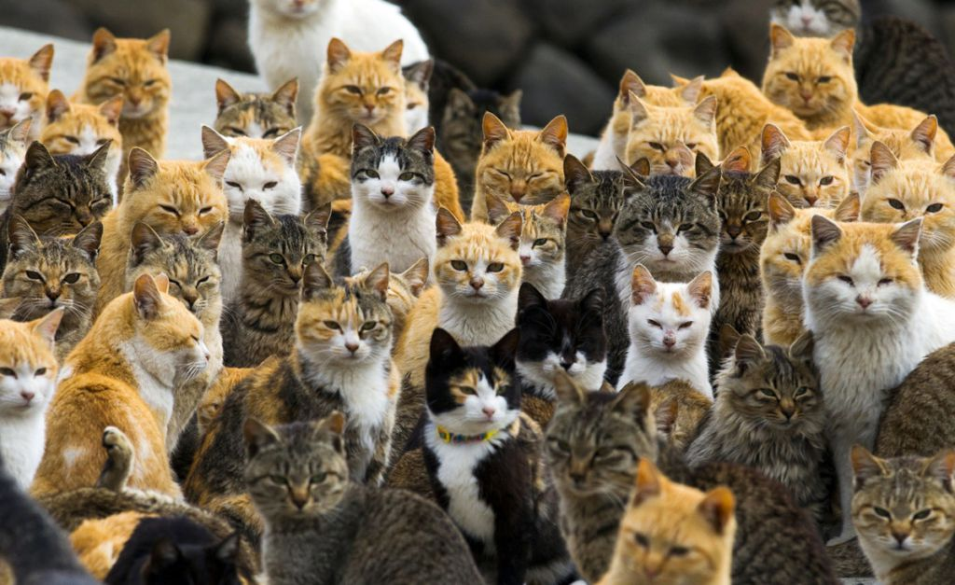
Detection as Regression?
CAT, (x, y, w, h)
CAT, (x, y, w, h)
….
CAT (x, y, w, h)
= many numbers
Need variable sized outputs

Slide 38
Detection as Classification
CAT? NO
DOG? NO

Slide 39
Detection as Classification
CAT? YES!
DOG? NO

Slide 40
Detection as Classification
CAT? NO
DOG? NO

Slide 41
Detection as Classification
Problem: Need to test many positions and scales
Solution: If your classifier is fast enough, just do it

Slide 42
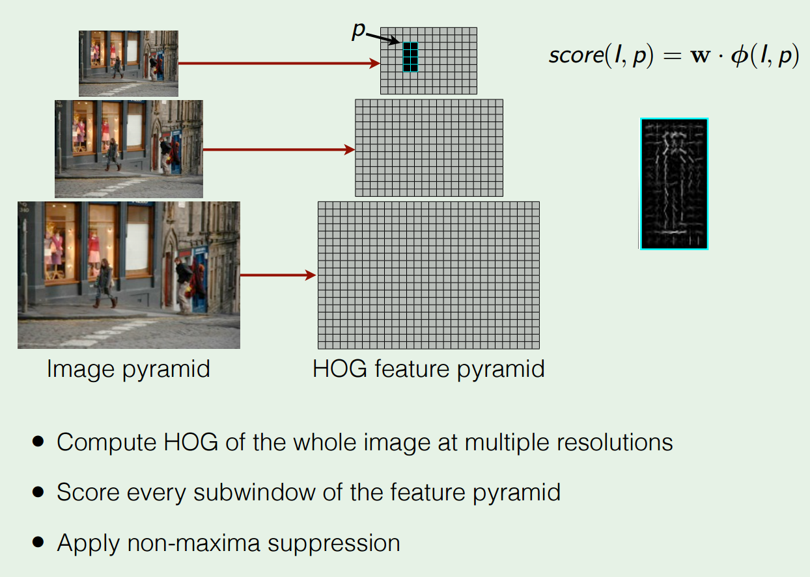
Histogram of Oriented Gradients
Dalal and Triggs, “Histograms of Oriented Gradients for Human Detection”, CVPR 2005 Slide credit: Ross Girshick

Slide 43
Detection as Classification
Problem: Need to test many positions and scales, and use a computationally demanding classifier (CNN)
Solution: Only look at a tiny subset of possible positions

Slide 44
Region Proposals
Find “blobby” image regions that are likely to contain objects
“Class-agnostic” object detector
Look for “blob-like” regions

Slide 45
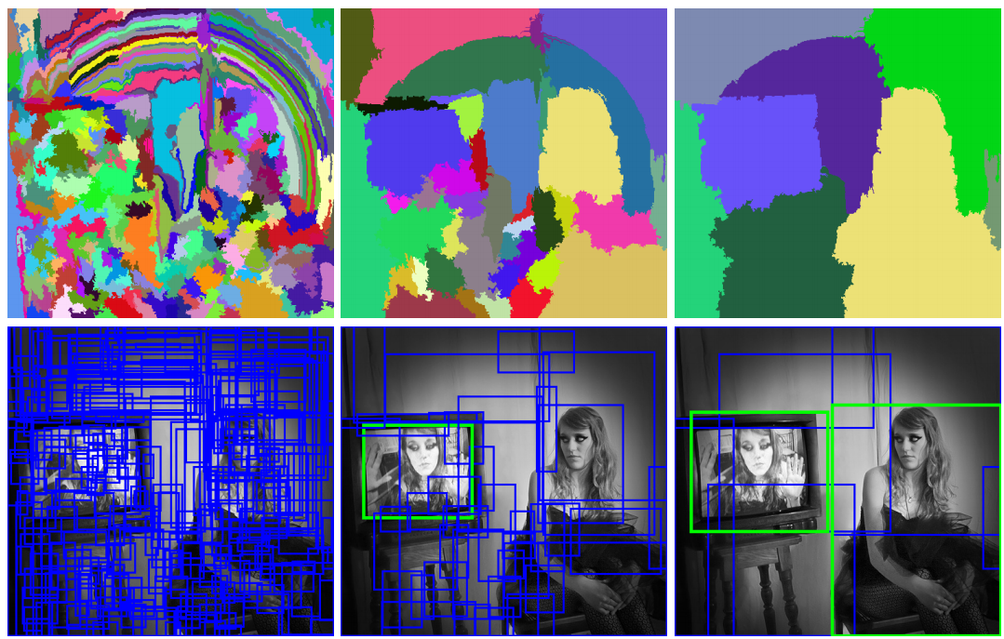
Region Proposals: Selective Search
Bottom-up segmentation, merging regions at multiple scales
Convert regions to boxes
Uijlings et al, “Selective Search for Object Recognition”, IJCV 2013

Slide 46
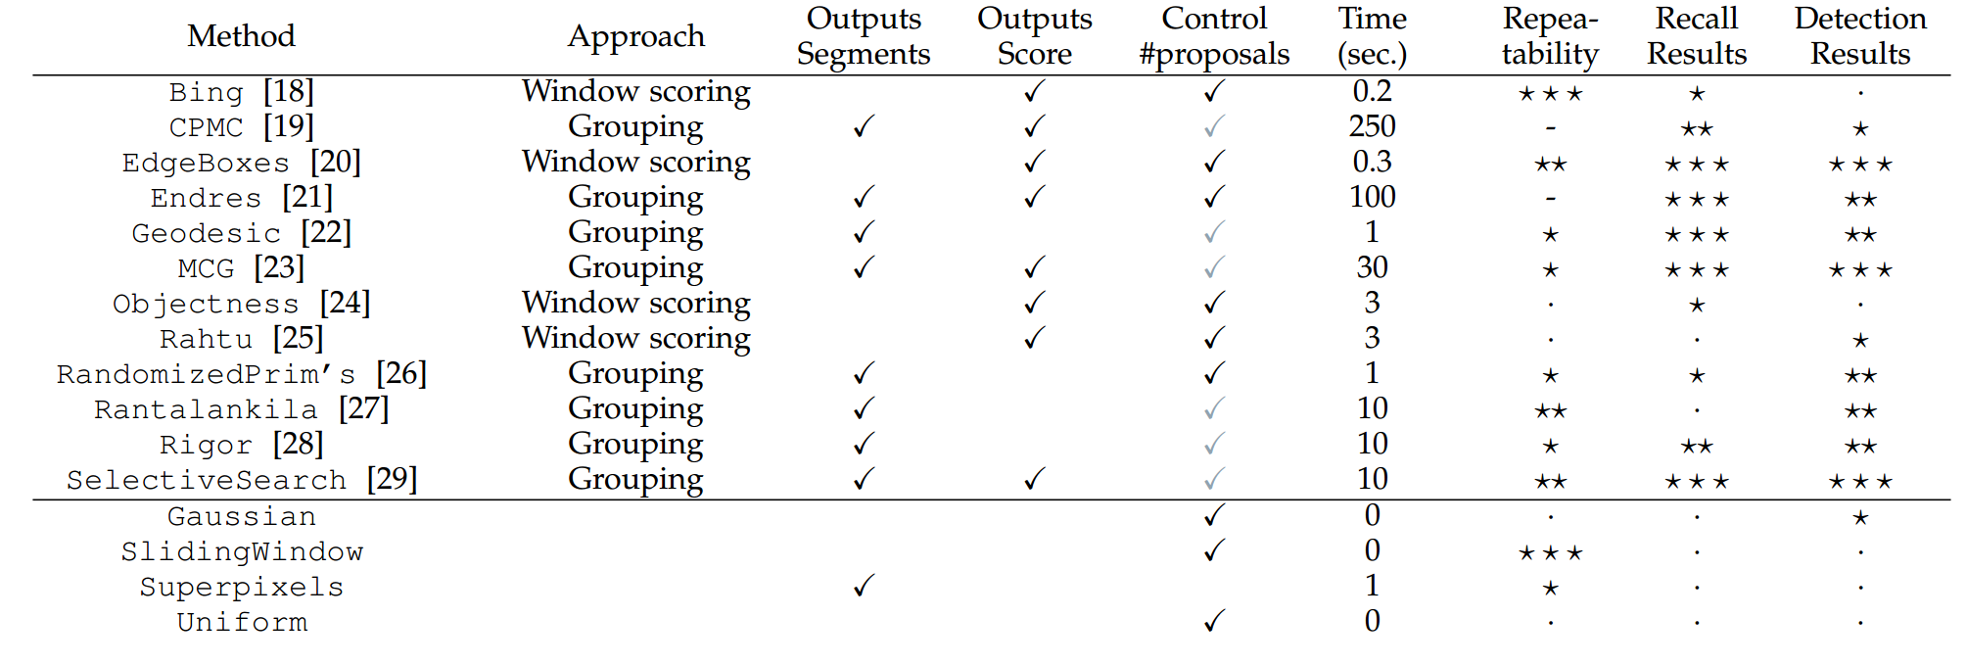
Region Proposals: Many other choices
Hosang et al, “What makes for effective detection proposals?”, PAMI 2015

Slide 47
Region Proposals: Many other choices
Hosang et al, “What makes for effective detection proposals?”, PAMI 2015

Slide 48
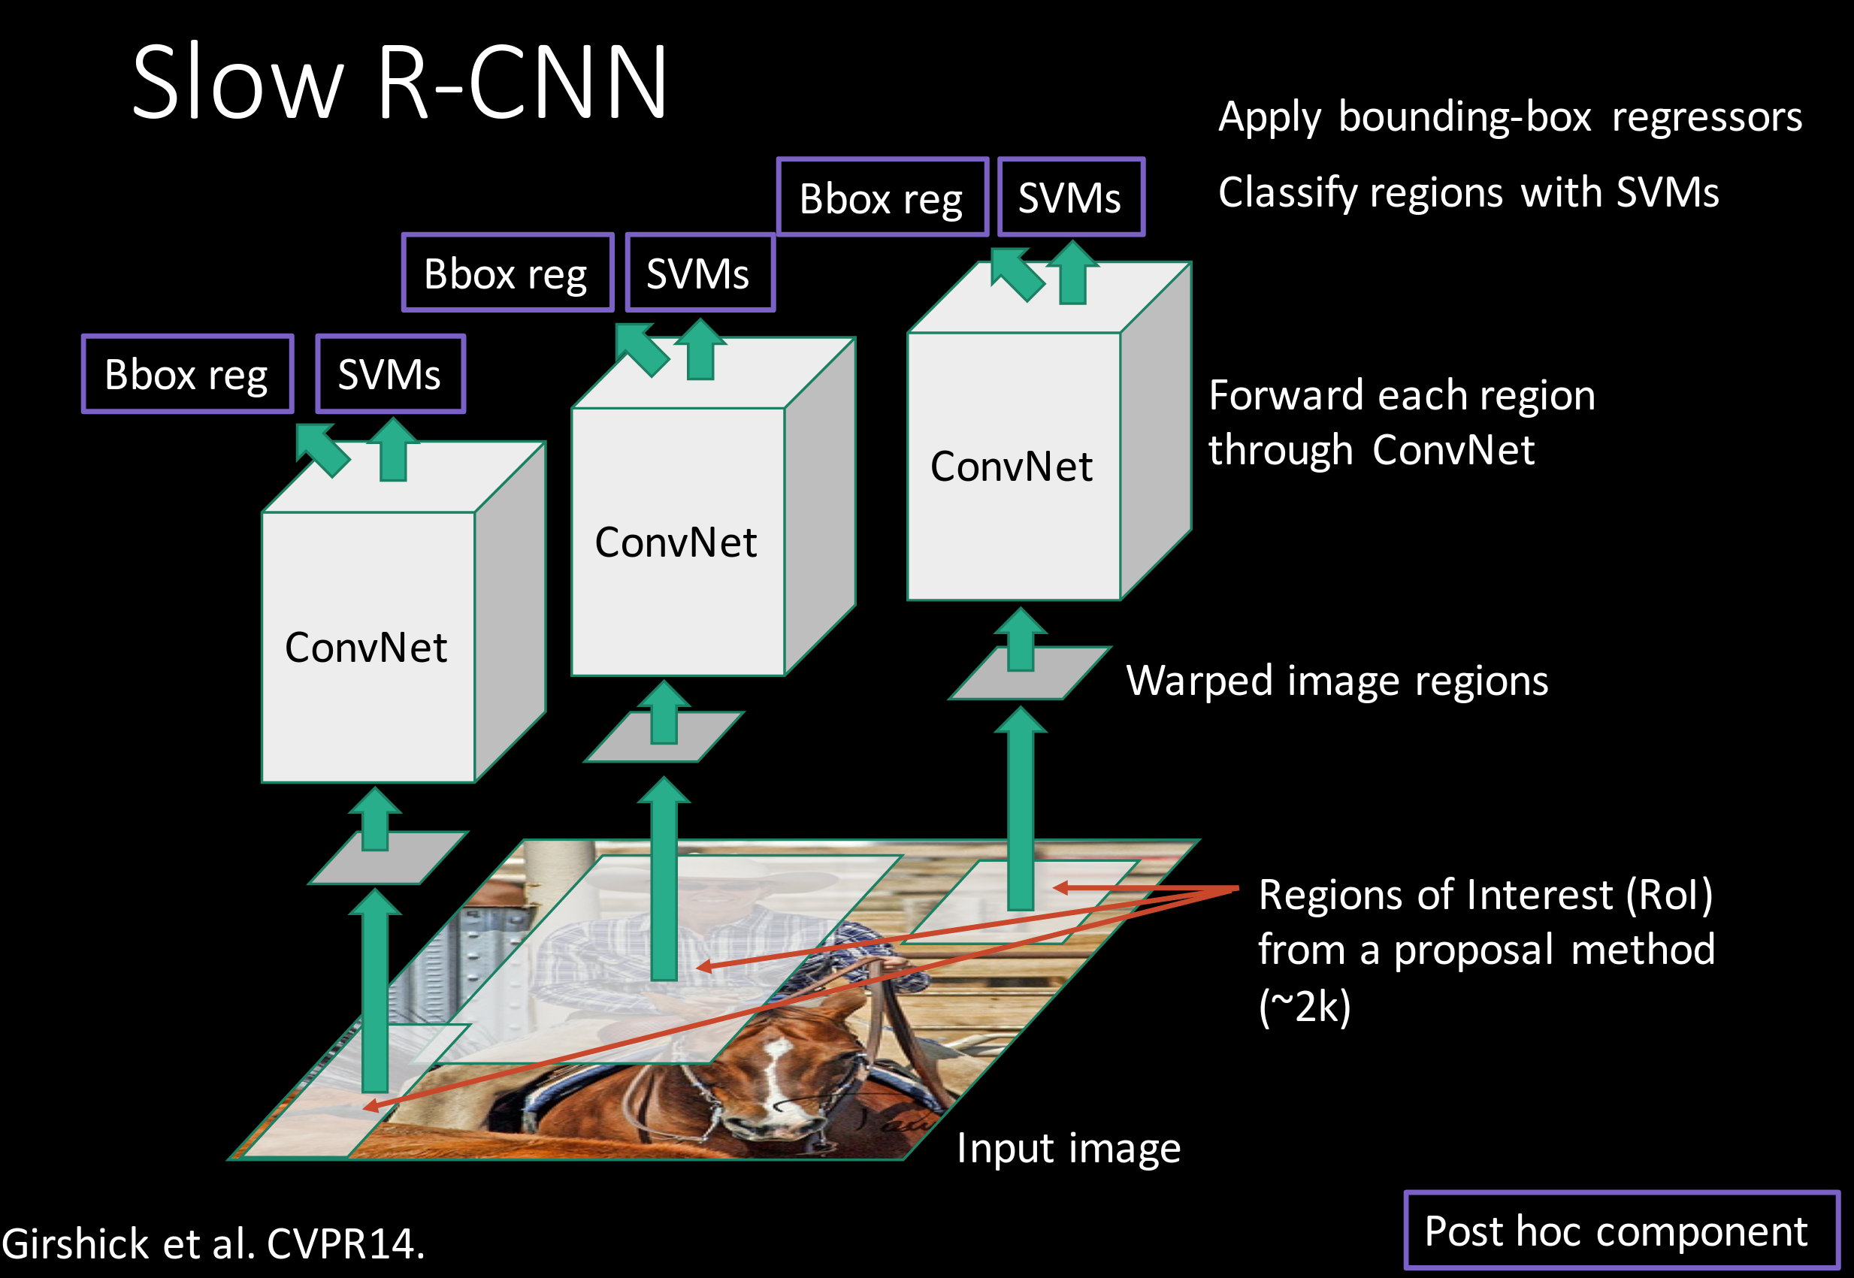
Putting it together: R-CNN
Girschick et al, “Rich feature hierarchies for accurate object detection and semantic segmentation”, CVPR 2014 Slide credit: Ross Girschick

Slide 49
R-CNN Training
Step 1: Train (or download) a classification model for ImageNet (AlexNet)
Convolution
and Pooling
Fully-connected layers
Softmax loss
Final conv feature map
Class scores 1000 classes
Image

Slide 50
R-CNN Training
Step 2: Fine-tune model for detection
Instead of 1000 ImageNet classes, want 20 object classes + background
Throw away final fully-connected layer, reinitialize from scratch
Keep training model using positive / negative regions from detection images
Re-initialize this layer: was 4096 x 1000, now will be 4096 x 21
Convolution
and Pooling
Fully-connected layers
Softmax loss
Final conv feature map
Class scores: 21 classes
Image

Slide 51
R-CNN Training
Step 3: Extract features
Extract region proposals for all images
For each region: warp to CNN input size, run forward through CNN, save pool5 features to disk
Have a big hard drive: features are ~200GB for PASCAL dataset!
Convolution
and Pooling
pool5 features
Image
Region Proposals
Crop + Warp
Forward pass
Save to disk

Slide 52
R-CNN Training
Step 4: Train one binary SVM per class to classify region features
Training image regions
Cached region features
Positive samples for cat SVM
Negative samples for cat SVM

Slide 53
R-CNN Training
Step 4: Train one binary SVM per class to classify region features
Training image regions
Cached region features
Negative samples for dog SVM
Positive samples
for dog SVM

Slide 54
R-CNN Training
Step 5 (bbox regression): For each class, train a linear regression model to map from cached features to offsets to GT boxes to make up for “slightly wrong” proposals
Training image regions
Cached region features
Regression targets
(dx, dy, dw, dh)
Normalized coordinates
(0, 0, 0, 0) Proposal is good
(.25, 0, 0, 0) Proposal too far to left
(0, 0, -0.125, 0) Proposal too wide

Slide 55
Object Detection: Datasets
 | PASCAL VOC (2010) | ImageNet Detection (ILSVRC 2014) | MS-COCO (2014)
Number of classes | 20 | 200 | 80
Number of images (train + val) | ~20k | ~470k | ~120k
Mean objects per image | 2.4 | 1.1 | 7.2

Slide 56
Object Detection: Evaluation
We use a metric called “mean average precision” (mAP)
Compute average precision (AP) separately for each class, then average over classes
A detection is a true positive if it has IoU with a ground-truth box greater than some threshold (usually 0.5) (mAP@0.5)
Combine all detections from all test images to draw a precision / recall curve for each class; AP is area under the curve
TL;DR mAP is a number from 0 to 100; high is good

Slide 57
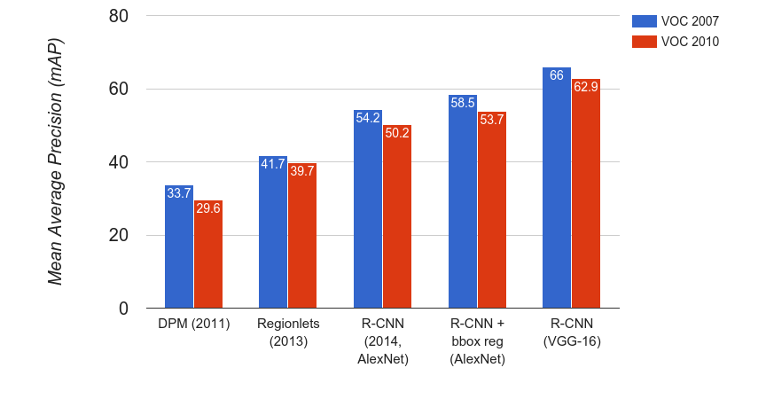
R-CNN Results
Wang et al, “Regionlets for Generic Object Detection”, ICCV 2013

Slide 58
R-CNN Results
Big improvement compared to pre-CNN methods

Slide 59
R-CNN Results
Bounding box regression helps a bit

Slide 60
R-CNN Results
Features from a deeper network help a lot

Slide 61
R-CNN Problems
Slow at test-time: need to run full forward pass of CNN for each region proposal
SVMs and regressors are post-hoc: CNN features not updated in response to SVMs and regressors
Complex multistage training pipeline

Slide 62
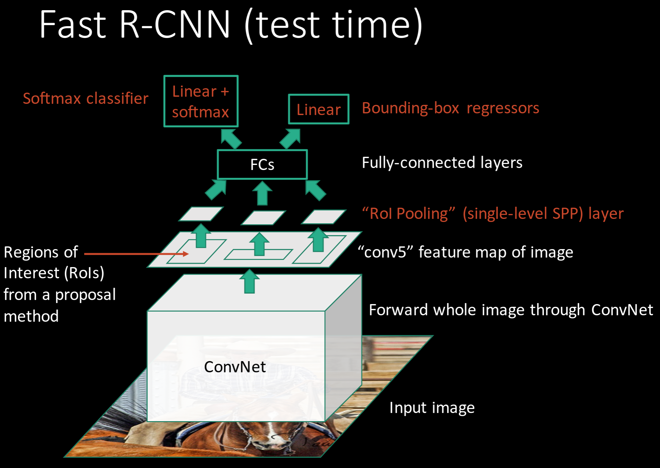
Girschick, “Fast R-CNN”, ICCV 2015 Slide credit: Ross Girschick

Slide 63
R-CNN Problem #1: Slow at test-time due to independent forward passes of the CNN
Solution: Share computation of convolutional layers between proposals for an image

Slide 64
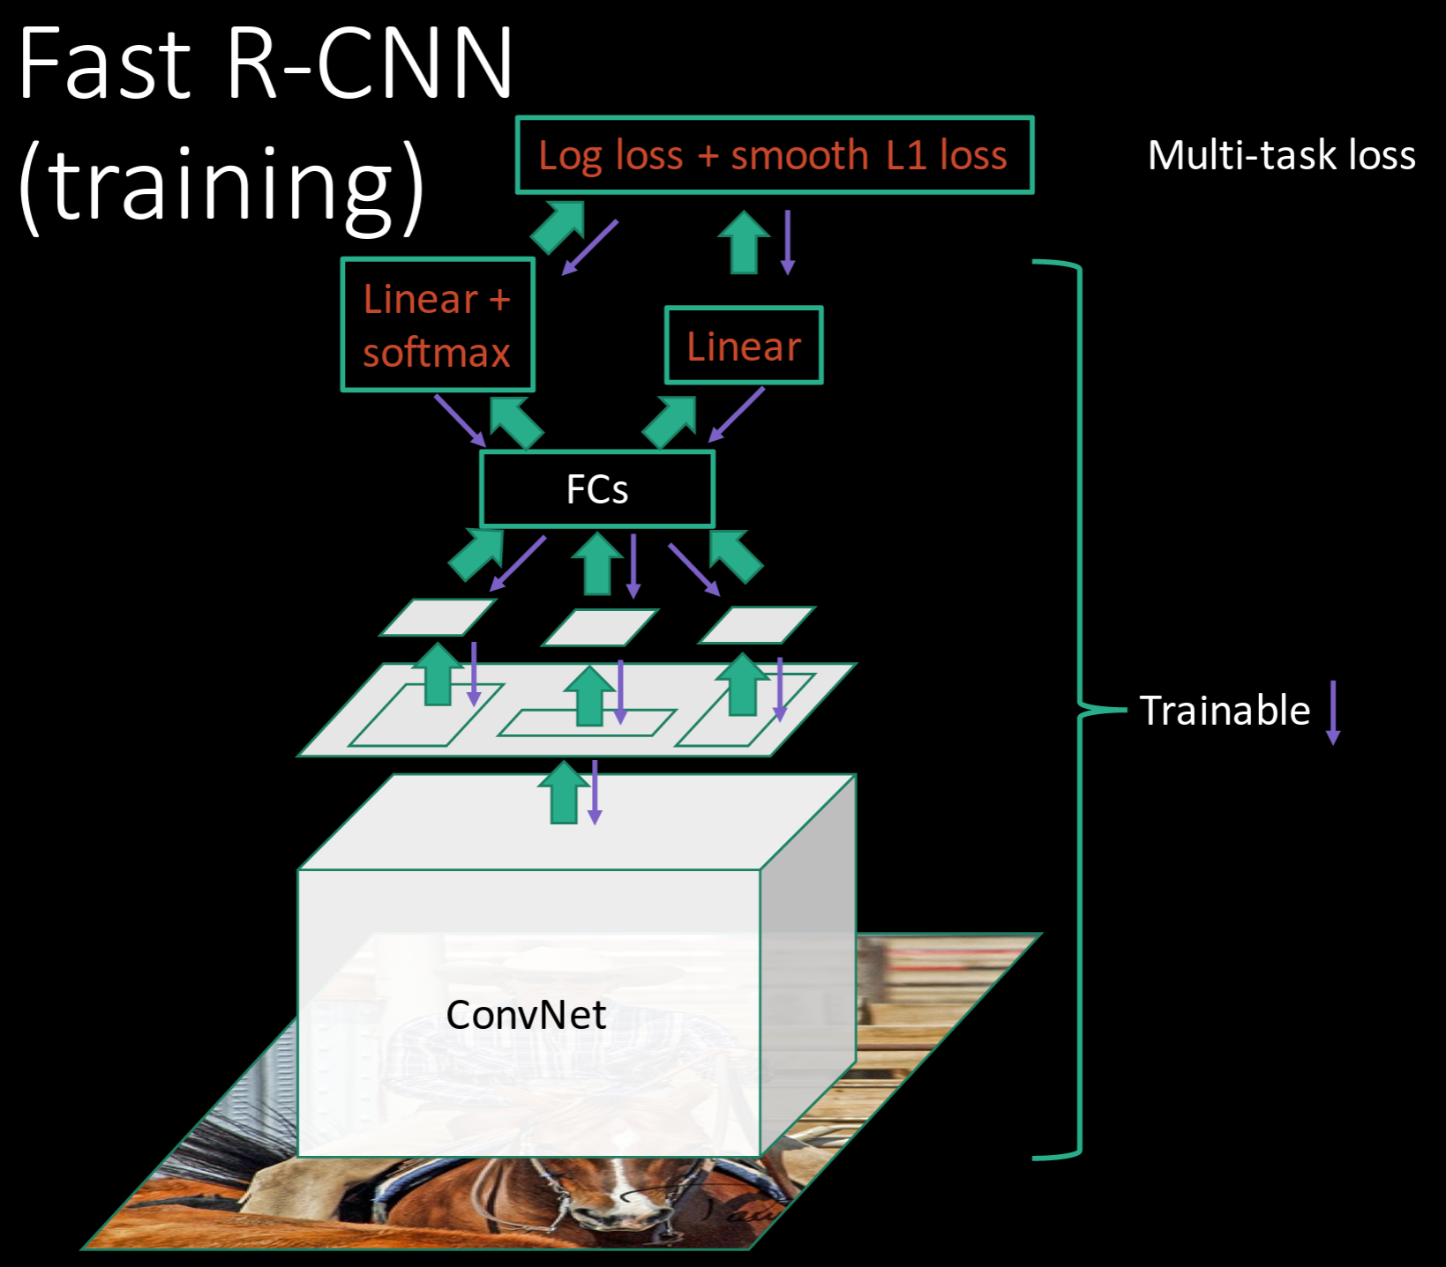
R-CNN Problem #2: Post-hoc training: CNN not updated in response to final classifiers and regressors
R-CNN Problem #3:
Complex training pipeline
Solution:
Just train the whole system end-to-end all at once!
Slide credit: Ross Girschick

Slide 65
Fast R-CNN: Region of Interest Pooling
Convolution
and Pooling
Fully-connected layers
Hi-res input image:
3 x 800 x 600 with region proposal
Hi-res conv features:
C x H x W with region proposal
Problem: Fully-connected layers expect low-res conv features: C x h x w

Slide 66
Fast R-CNN: Region of Interest Pooling
Project region proposal onto conv feature map
Convolution
and Pooling
Fully-connected layers
Hi-res input image:
3 x 800 x 600 with region proposal
Hi-res conv features:
C x H x W with region proposal
Problem: Fully-connected layers expect low-res conv features: C x h x w

Slide 67
Fast R-CNN: Region of Interest Pooling
Convolution
and Pooling
Divide projected region into h x w grid
Fully-connected layers
Hi-res input image:
3 x 800 x 600 with region proposal
Hi-res conv features:
C x H x W with region proposal
Problem: Fully-connected layers expect low-res conv features: C x h x w

Slide 68
Fast R-CNN: Region of Interest Pooling
Max-pool within each grid cell
Convolution
and Pooling
Fully-connected layers
Hi-res input image:
3 x 800 x 600 with region proposal
Hi-res conv features:
C x H x W with region proposal
RoI conv features:
C x h x w for region proposal
Fully-connected layers expect low-res conv features: C x h x w

Slide 69
Fast R-CNN: Region of Interest Pooling
Can back propagate similar to max pooling
Convolution
and Pooling
Fully-connected layers
Hi-res input image:
3 x 800 x 600 with region proposal
Hi-res conv features:
C x H x W with region proposal
RoI conv features:
C x h x w for region proposal
Fully-connected layers expect low-res conv features: C x h x w

Slide 70
Fast R-CNN: Region of Interest Pooling

Slide 71
Fast R-CNN Results
 | R-CNN | Fast R-CNN
Training Time: | 84 hours | 9.5 hours
(Speedup) | 1x | 8.8x
Faster!
Using VGG-16 CNN on Pascal VOC 2007 dataset

Slide 72
Fast R-CNN Results
 | R-CNN | Fast R-CNN
Training Time: | 84 hours | 9.5 hours
(Speedup) | 1x | 8.8x
Test time per image | 47 seconds | 0.32 seconds
(Speedup) | 1x | 146x
Faster!
FASTER!
Using VGG-16 CNN on Pascal VOC 2007 dataset

Slide 73
Fast R-CNN Results
 | R-CNN | Fast R-CNN
Training Time: | 84 hours | 9.5 hours
(Speedup) | 1x | 8.8x
Test time per image | 47 seconds | 0.32 seconds
(Speedup) | 1x | 146x
mAP (VOC 2007) | 66.0 | 66.9
Faster!
FASTER!
Better!
Using VGG-16 CNN on Pascal VOC 2007 dataset

Slide 74
Fast R-CNN Problem:
Test-time speeds don’t include region proposals
 | R-CNN | Fast R-CNN
Test time per image | 47 seconds | 0.32 seconds
(Speedup) | 1x | 146x
Test time per image with Selective Search | 50 seconds | 2 seconds
(Speedup) | 1x | 25x

Slide 75
Fast R-CNN Problem Solution:
Test-time speeds don’t include region proposals Just make the CNN do region proposals too!
 | R-CNN | Fast R-CNN
Test time per image | 47 seconds | 0.32 seconds
(Speedup) | 1x | 146x
Test time per image with Selective Search | 50 seconds | 2 seconds
(Speedup) | 1x | 25x

Slide 76
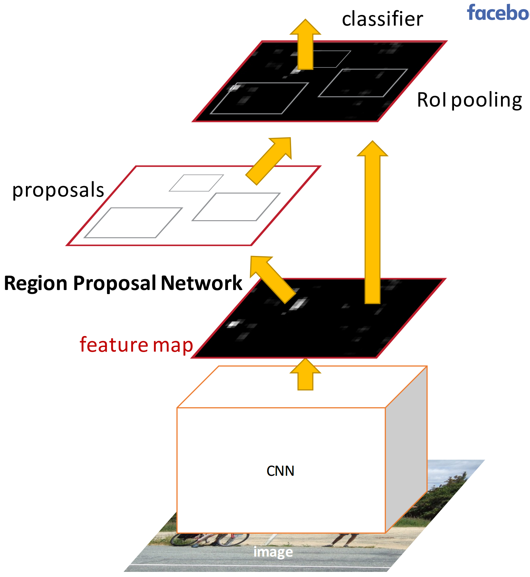
Faster R-CNN:
Insert a Region Proposal Network (RPN) after the last convolutional layer
RPN trained to produce region proposals directly; no need for external region proposals!
After RPN, use RoI Pooling and an upstream classifier and bbox regressor just like Fast R-CNN
Ren et al, “Faster R-CNN: Towards Real-Time Object Detection with Region Proposal Networks”, NIPS 2015 Slide credit: Ross Girschick

Slide 77
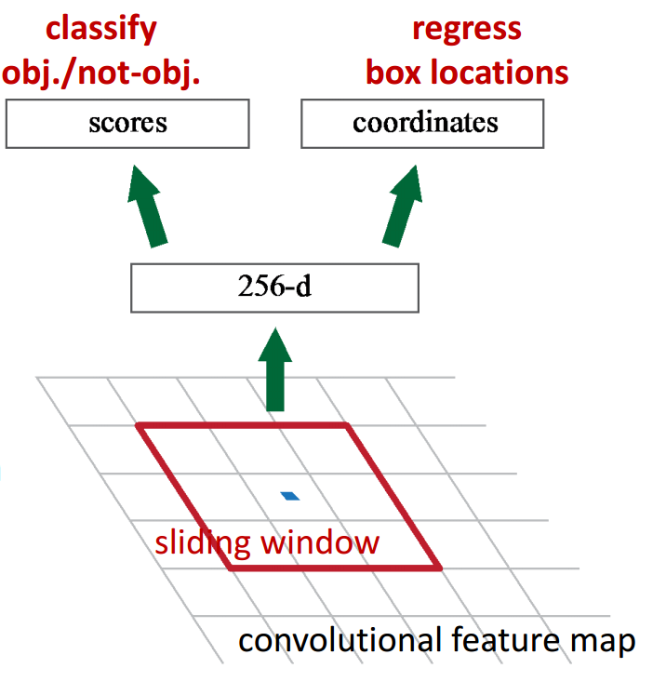
Faster R-CNN: Region Proposal Network
Slide a small window on the feature map
Build a small network for:
• classifying object or not-object, and
• regressing bbox locations
Position of the sliding window provides localization information with reference to the image
Box regression provides finer localization information with reference to this sliding window
1 x 1 conv
1 x 1 conv
1 x 1 conv
Slide credit: Kaiming He

Slide 78
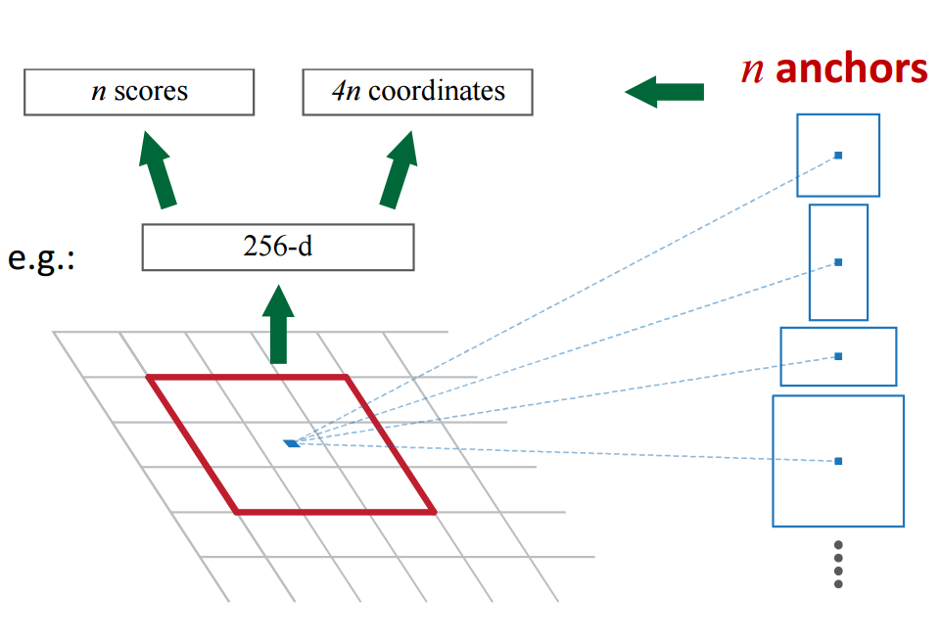
Faster R-CNN: Region Proposal Network
Use N anchor boxes at each location
Anchors are translation invariant: use the same ones at every location
Regression gives offsets from anchor boxes
Classification gives the probability that each (regressed) anchor shows an object

Slide 79
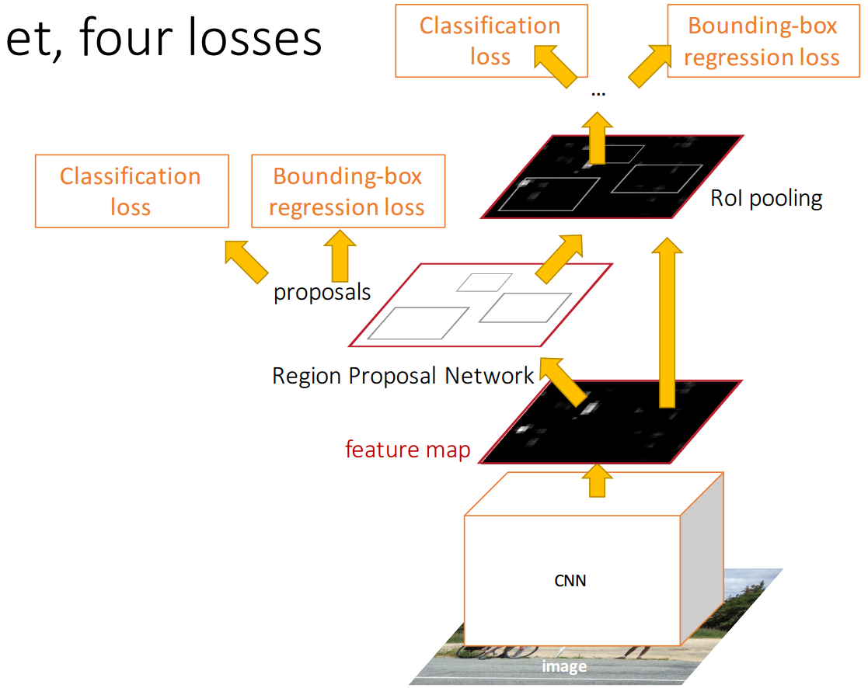
Faster R-CNN: Training
In the paper: Ugly pipeline
Use alternating optimization to train RPN, then Fast R-CNN with RPN proposals, etc.
More complex than it has to be
Since publication: Joint training! One network, four losses
RPN classification (anchor good / bad)
RPN regression (anchor -> proposal)
Fast R-CNN classification (over classes)
Fast R-CNN regression (proposal -> box)
Slide credit: Ross Girschick

Slide 80
Faster R-CNN: Results
 | R-CNN | Fast R-CNN | Faster R-CNN
Test time per image (with proposals) | 50 seconds | 2 seconds | 0.2 seconds
(Speedup) | 1x | 25x | 250x
mAP (VOC 2007) | 66.0 | 66.9 | 66.9

Slide 81
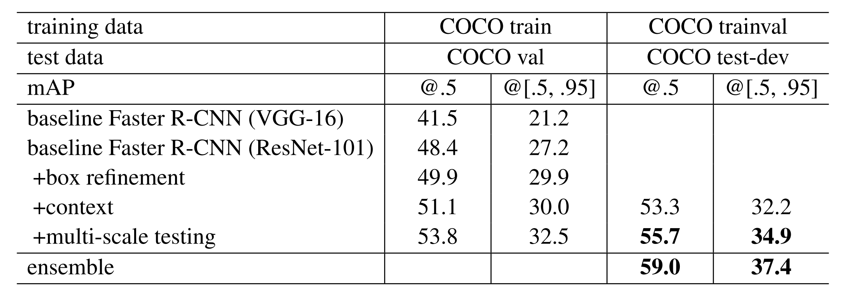
Object Detection State-of-the-art: ResNet 101 + Faster R-CNN + some extras
He et. al, “Deep Residual Learning for Image Recognition”, arXiv 2015

Slide 82
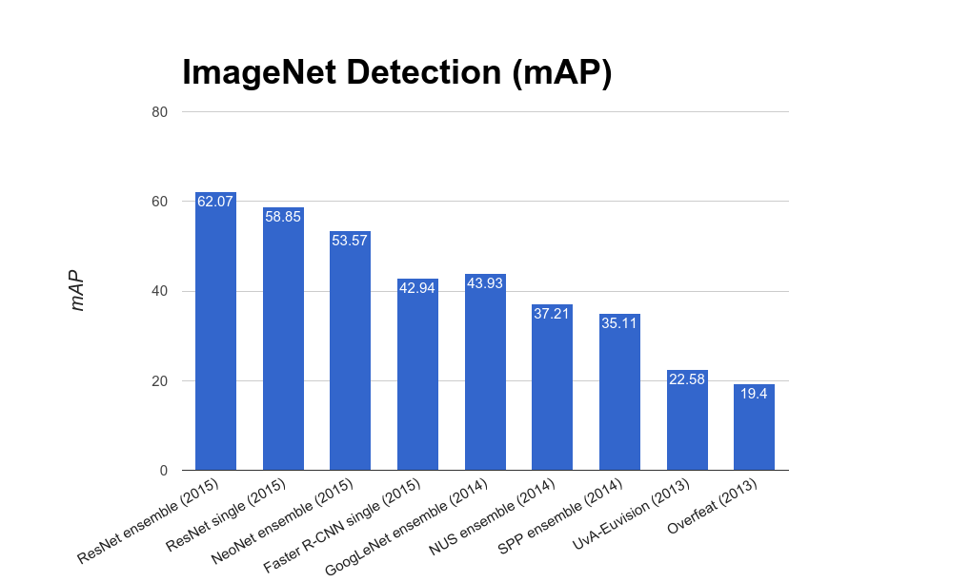
ImageNet Detection 2013 - 2015

Slide 83
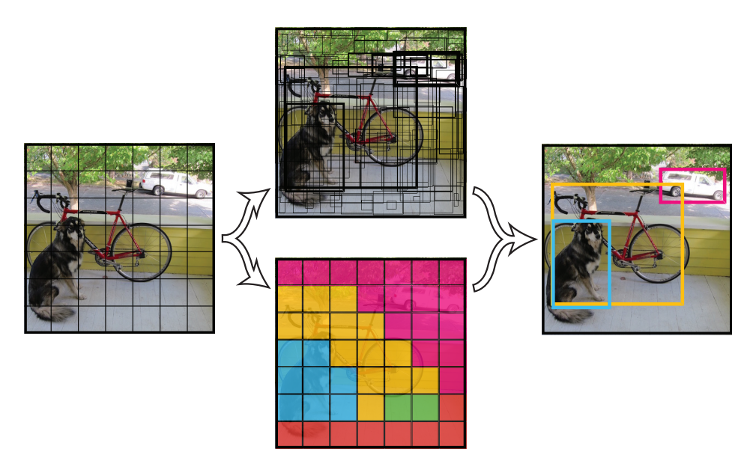
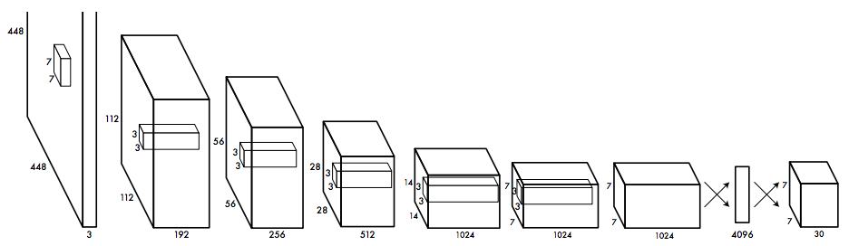
YOLO: You Only Look Once
Detection as Regression
Divide image into S x S grid
Within each grid cell predict:
B Boxes: 4 coordinates + confidence
Class scores: C numbers
Regression from image to 7 x 7 x (5 * B + C) tensor
Direct prediction using a CNN
Redmon et al, “You Only Look Once: Unified, Real-Time Object Detection”, arXiv 2015

Slide 84
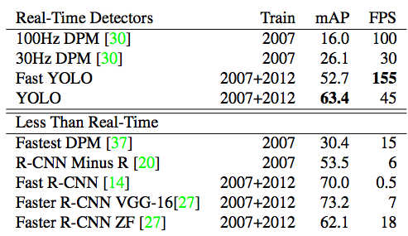
YOLO: You Only Look Once
Detection as Regression
Faster than Faster R-CNN, but not as good
Redmon et al, “You Only Look Once: Unified, Real-Time Object Detection”, arXiv 2015

Slide 85
Recap
Localization:
Find a fixed number of objects (one or many)
L2 regression from CNN features to box coordinates
Much simpler than detection; consider it for your projects!
Overfeat: Regression + efficient sliding window with FC -> conv conversion
Deeper networks do better
Object Detection:
Find a variable number of objects by classifying image regions
Before CNNs: dense multiscale sliding window (HoG, DPM)
Avoid dense sliding window with region proposals
R-CNN: Selective Search + CNN classification / regression
Fast R-CNN: Swap order of convolutions and region extraction
Faster R-CNN: Compute region proposals within the network
Deeper networks do better

